Slide 1
Protecting your CAR investment by SARAH LEE MARKS
Extended Service Contract, Gap Protection, Diminished Value
SERVICE and RECALLS,

Slide 2
EXTENDED SERVICE CONTRACTS
Are they worth it?
YES, on USED or Out of Warranty Cars.
Branded or not?
How long-$$$
Must you go back to the dealer?
Not always, BUT…
Coverages and Deductibles:
Read the fine print
Sensors
Computer boards
4WD-AWD
Luxury models
Exclusions

Slide 3
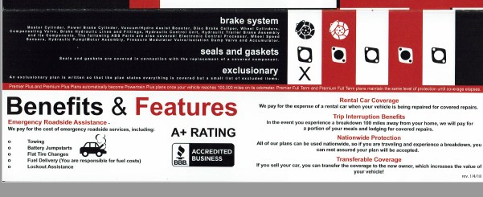
SAMPLE PLAN

Slide 4
GAP PROTECTION
LOAN/LEASE BALANCE COVERAGE
In the event the vehicle is stolen or declared a TOTAL LOSS
GAP PROTECTION pays the bank off for any loan balance due.
Leases usually include GAP but you may also be able to purchase GAP from your auto insurance company.
Loans over 100% LTV should have GAP protection.

Slide 5
DIMINISHED VALUE
The doughnut hole between your car being repaired and being a total loss, as a result of a crash caused by another party.
Diminished Value is the loss in Value caused by the BAD CARFAX REPORT.
You must have a Diminished Value Report by an Independent Appraiser in order to make a claim for Diminished Value.
Nevada Statute if Limitations is 3 years to make a claim/or file a law suit.

Slide 6
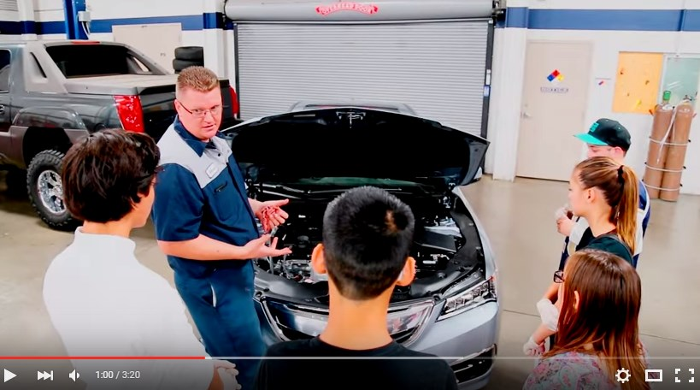
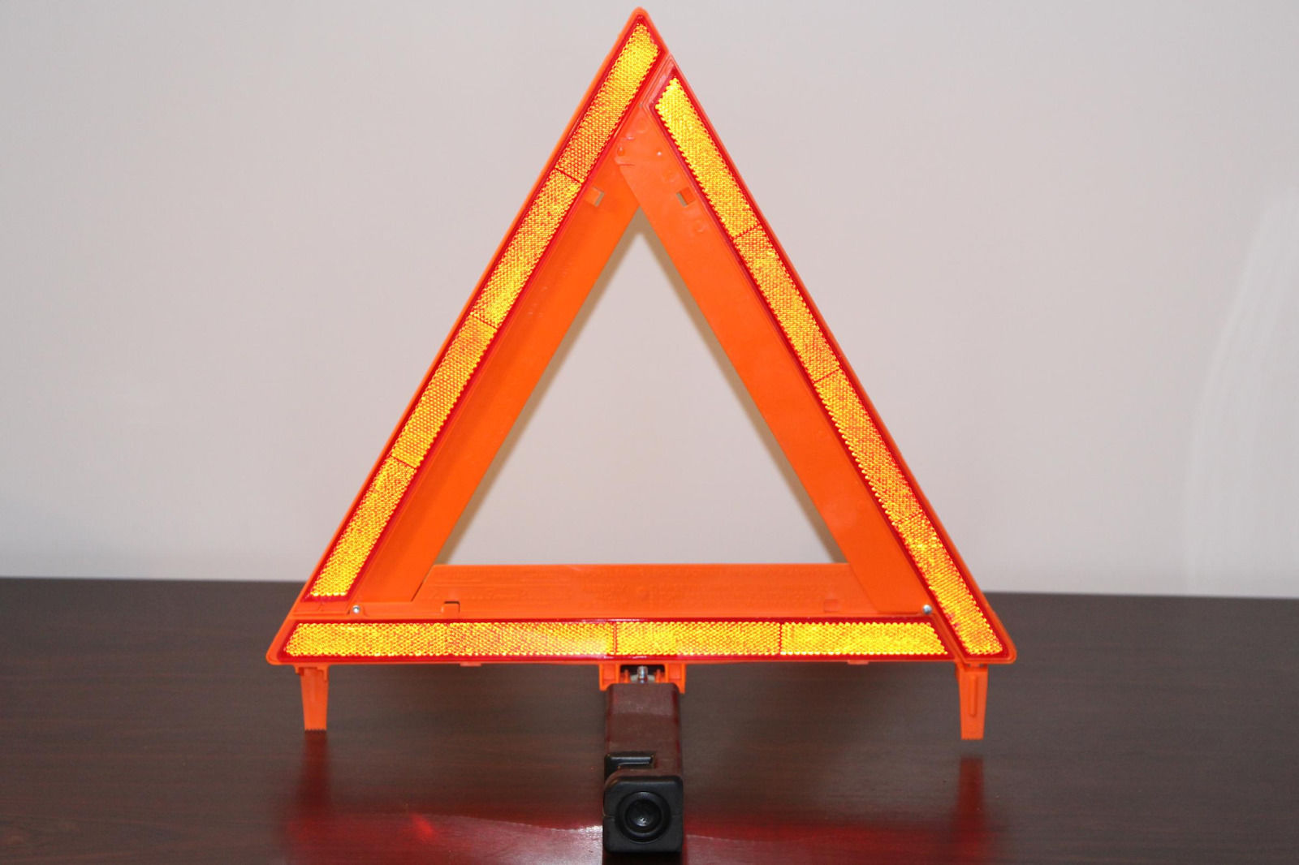
SERVICE and RECALLS
Visit the dealer at least 1 once a year for a check-up- software review.
Check SAFERCAR.gov or NHTSA.GOV every month for recalls.
Make sure all services are completed with GENUINE OEM parts.
Keep your service records for trade-in or sale time.
If you suspect the service estimate for repair is wrong, get a second opinion, ask for visual confirmation and shop the repair cost.
Use
AARP
Use AARP or other membership discount codes.

Slide 7
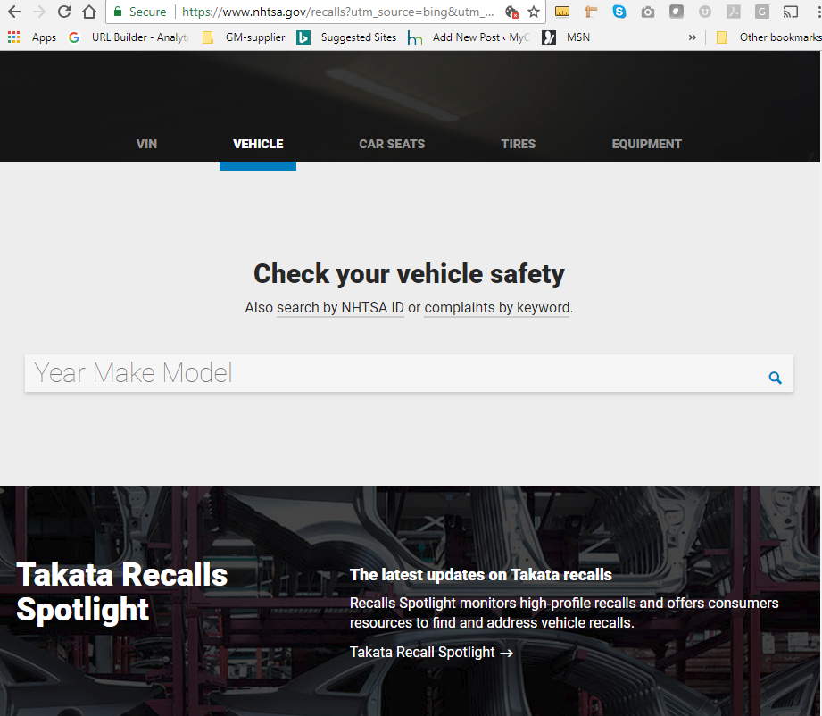
www.nhtsa.gov

Slide 8
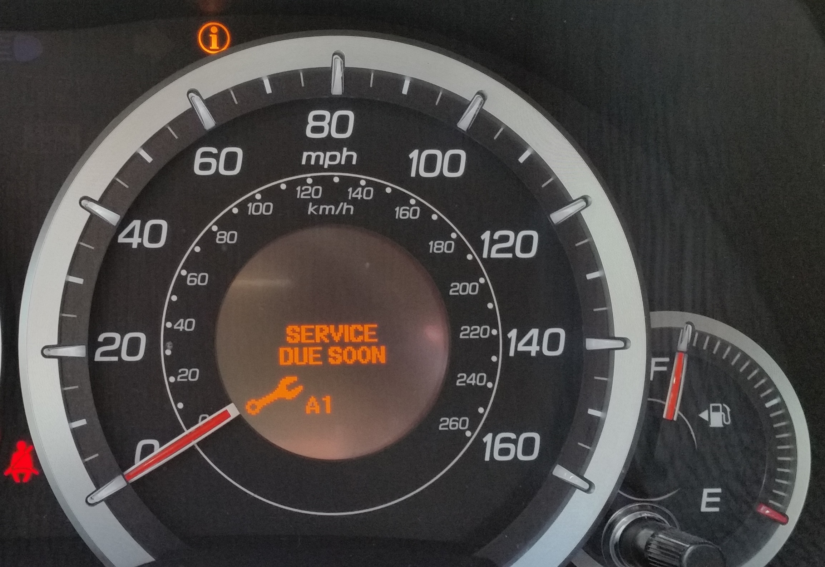
MYCARLADY’s 5 TIPS to Maximize the Value of your Car
1. Wash the car regularly.
2. Wax the exterior and shampoo the interior once a year.
3. Make sure all RECALLS are resolved.
4. Keep all service records and keys, cargo covers and factory rims
5. Do not add aftermarket parts, lift kits or non-factory trim that is not removable or warrantied by the brand.
ASK MYCARLADY A ? sarahlee@mycarlady.com

